Slide 1


Exhib
An exhibition Management System
Henrik Klarup
Jesper Riemer Andersen
Simon Reedtz Olesen
Jacob Karstensen Wortmann
Nicklas Andersen

Slide 2
Agenda
Motivation
Concept
Application Design
Application implementation
Website
Server communication
Conclusion
Demonstration
2 OF 17 | 15.02.2014
Department of computer science
AALBORG UNIVERSITy

Slide 3
Motivation
Jacob K. Wortmann

Slide 4
Motivation
concept
App design
Floor plan
Website
Server communication
conclusion
demonstration
System Motivation
Single application with multiple purposes
Indoors navigation
relevant information to users
Simple administration Tool
4 OF 17 | 15.02.2014
Department of computer science
AALBORG UNIVERSITy

Slide 5
Concept
Jacob K. Wortmann

Slide 6
Motivation
concept
App design
Floor plan
Website
Server communication
conclusion
demonstration
The exhib Concept
Example: Exhibition
generate the floor plan and data
scans a NFC tag to enter
relevant information(by feeds)
schedule of the exhibition
navigate to different booths
6 OF 17 | 15.02.2014
Department of computer science
AALBORG UNIVERSITy

Slide 7
Application Design
Simon Reedtz

Slide 8
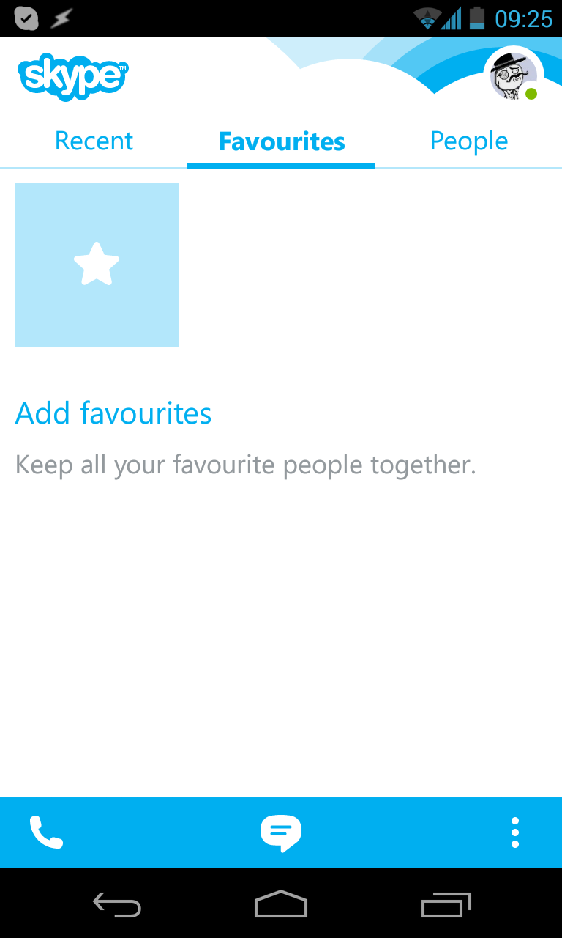
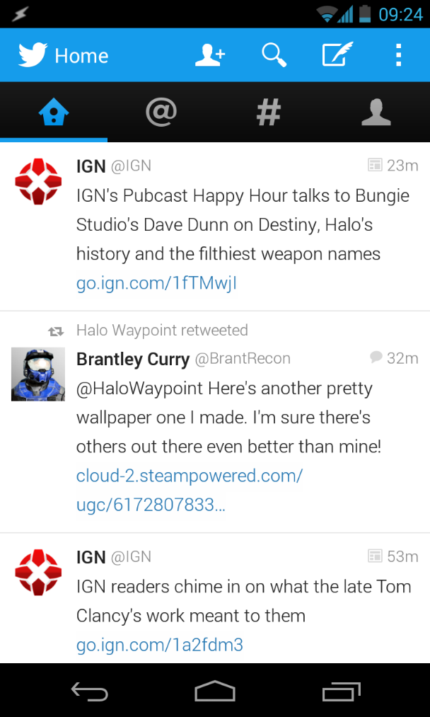
Motivation
concept
App design
Floor plan
Website
Server communication
conclusion
demonstration
Inspiration sources
Skype & Twitter
6 OF 17 | 15.02.2014
Department of computer science
AALBORG UNIVERSITy

Slide 9
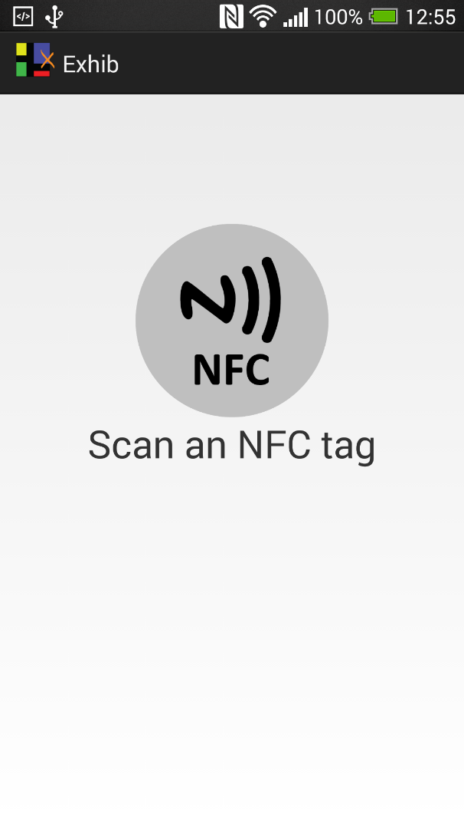
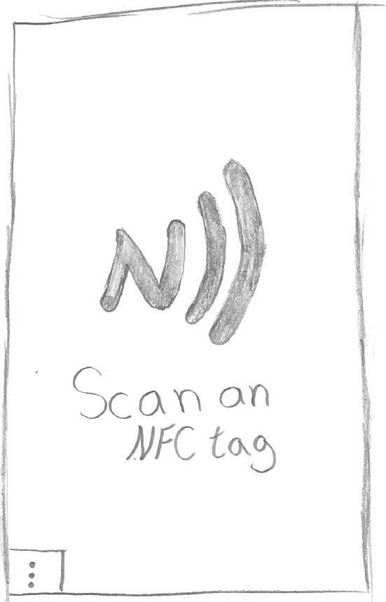
Motivation
concept
App design
Floor plan
Website
Server communication
conclusion
demonstration
Start screen
8 OF 17 | 15.02.2014
Department of computer science
AALBORG UNIVERSITy

Slide 10
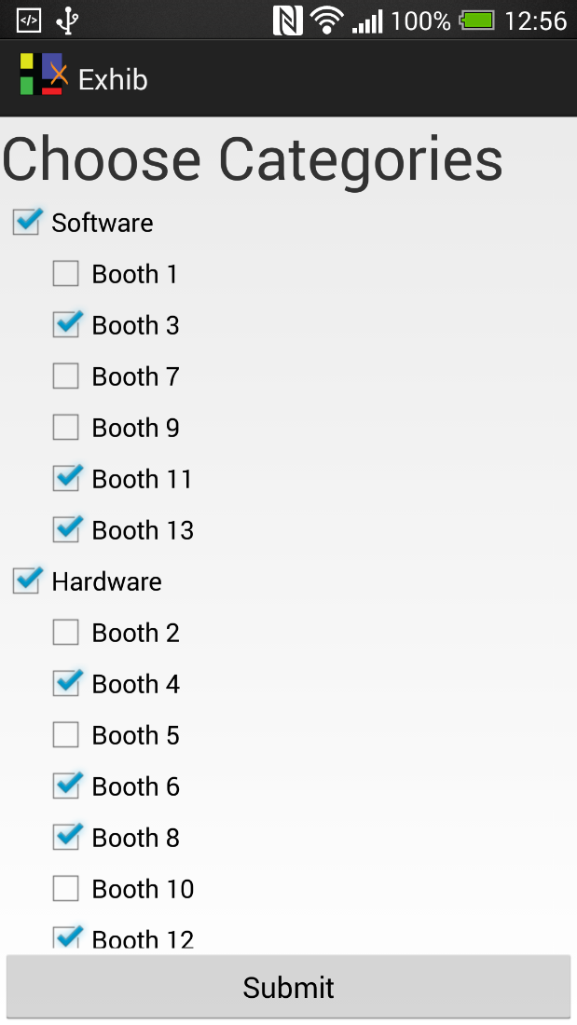
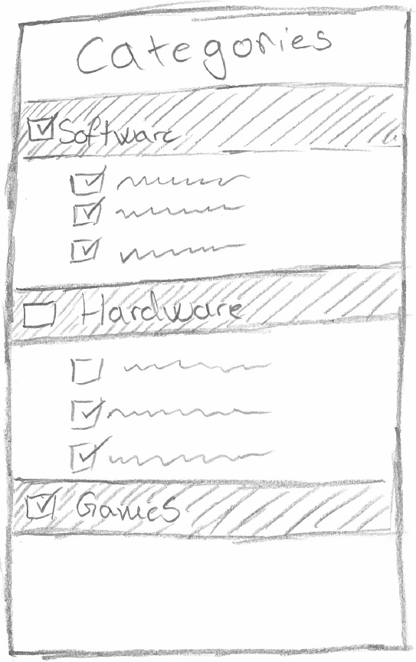
Motivation
concept
App design
Floor plan
Website
Server communication
conclusion
demonstration
Categories
8 OF 17 | 15.02.2014
Department of computer science
AALBORG UNIVERSITy

Slide 11
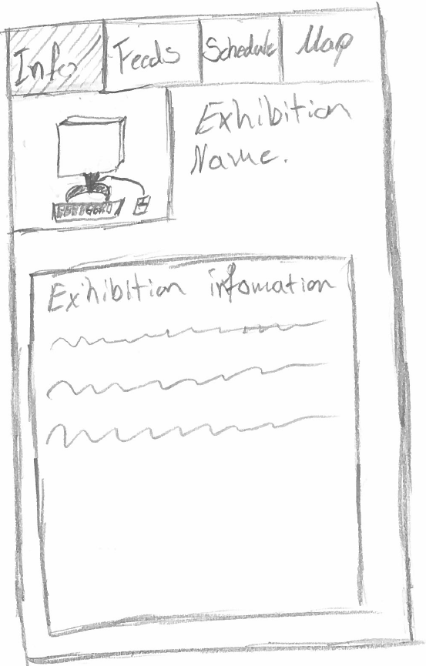
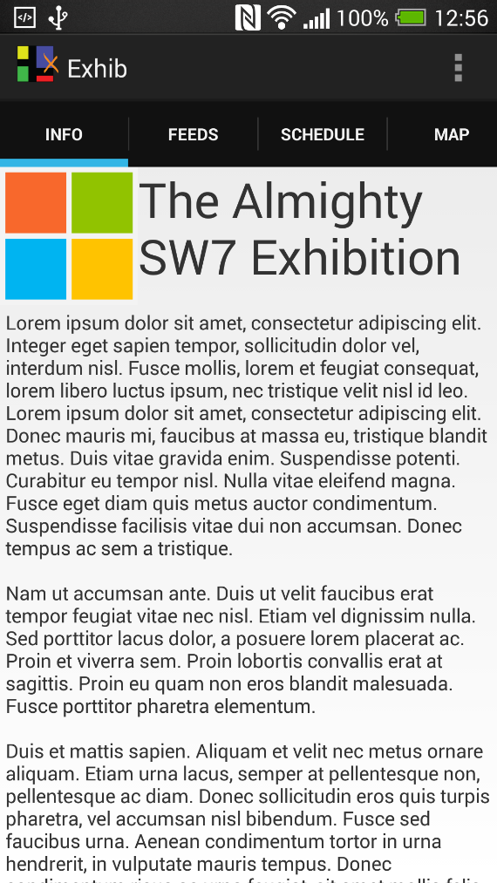
Motivation
concept
App design
Floor plan
Website
Server communication
conclusion
demonstration
Event Information
8 OF 17 | 15.02.2014
Department of computer science
AALBORG UNIVERSITy

Slide 12
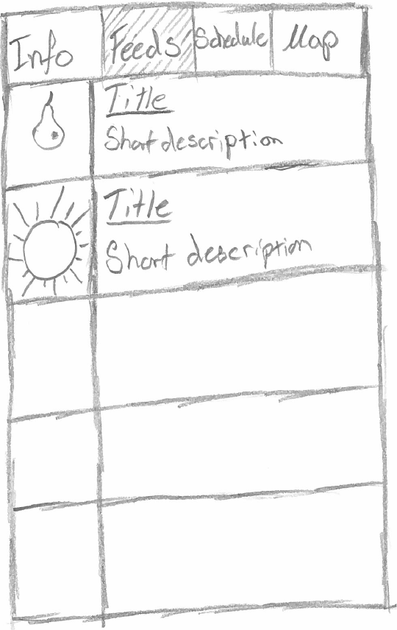
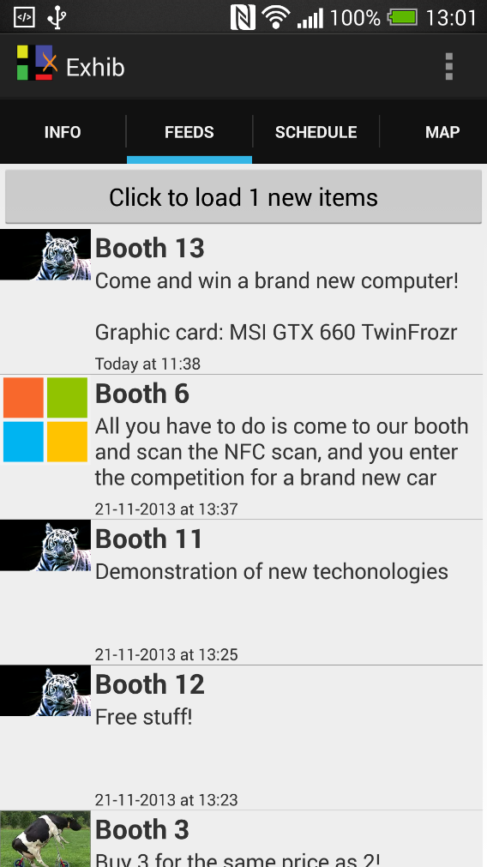
Motivation
concept
App design
Floor plan
Website
Server communication
conclusion
demonstration
Feeds
8 OF 17 | 15.02.2014
Department of computer science
AALBORG UNIVERSITy

Slide 13
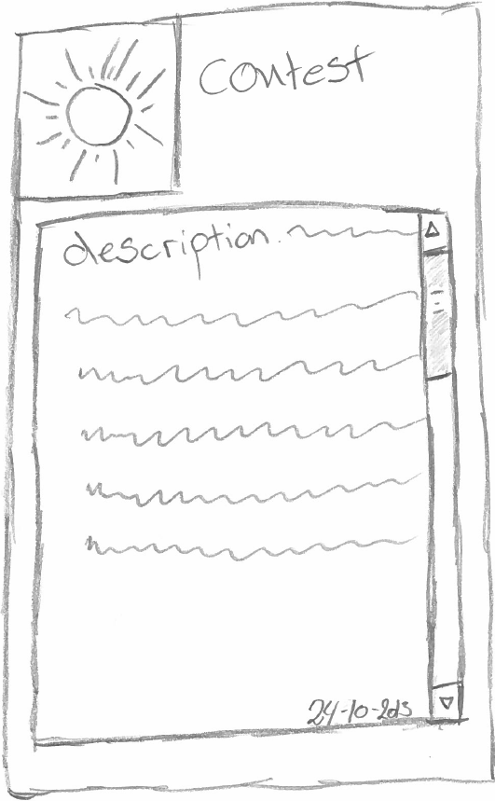
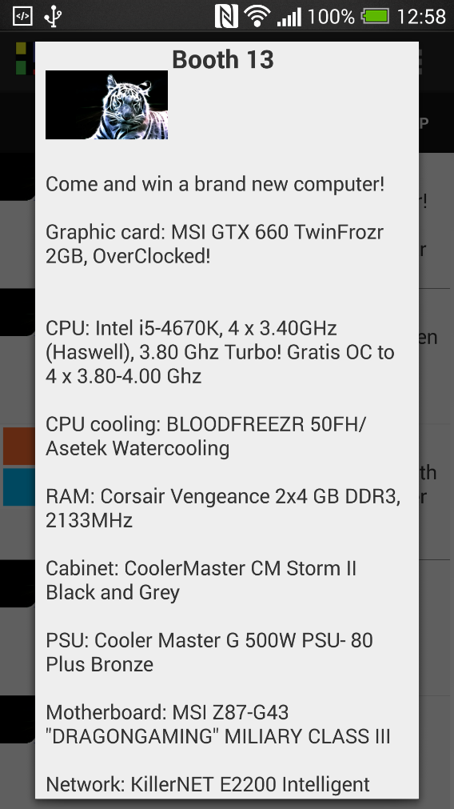
Motivation
concept
App design
Floor plan
Website
Server communication
conclusion
demonstration
Feed popup
8 OF 17 | 15.02.2014
Department of computer science
AALBORG UNIVERSITy

Slide 14
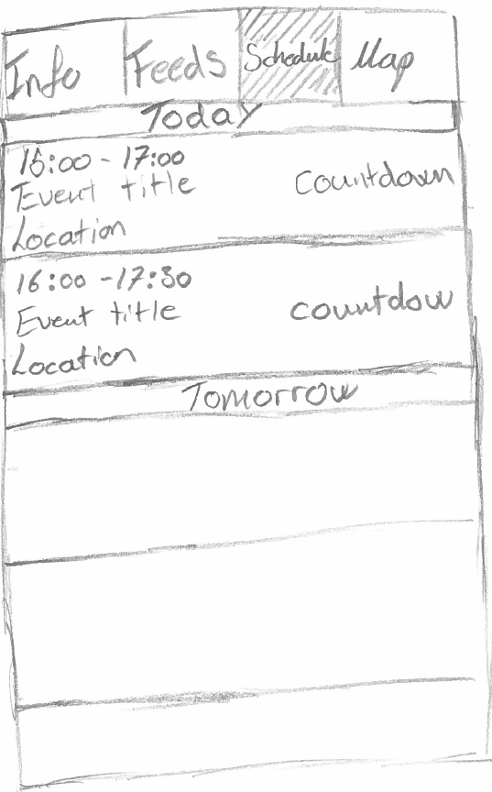
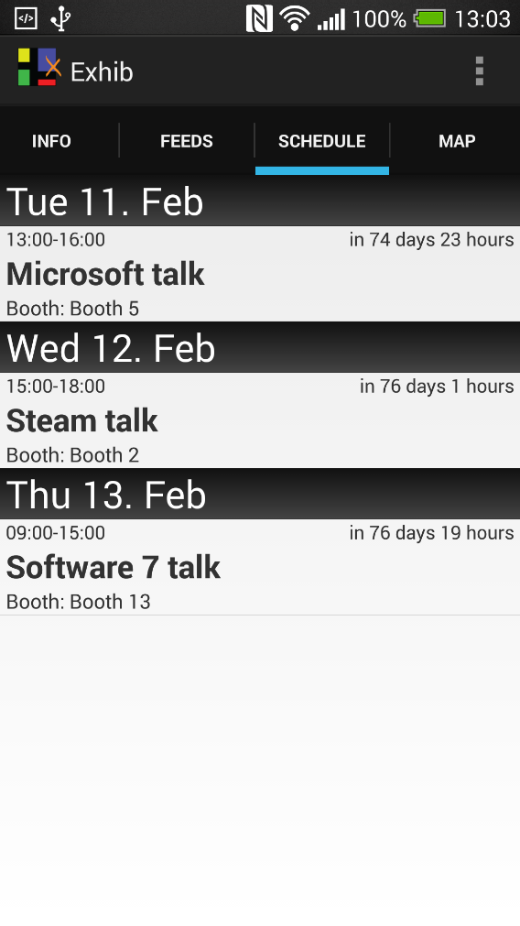
Motivation
concept
App design
Floor plan
Website
Server communication
conclusion
demonstration
Schedule
8 OF 17 | 15.02.2014
Department of computer science
AALBORG UNIVERSITy

Slide 15
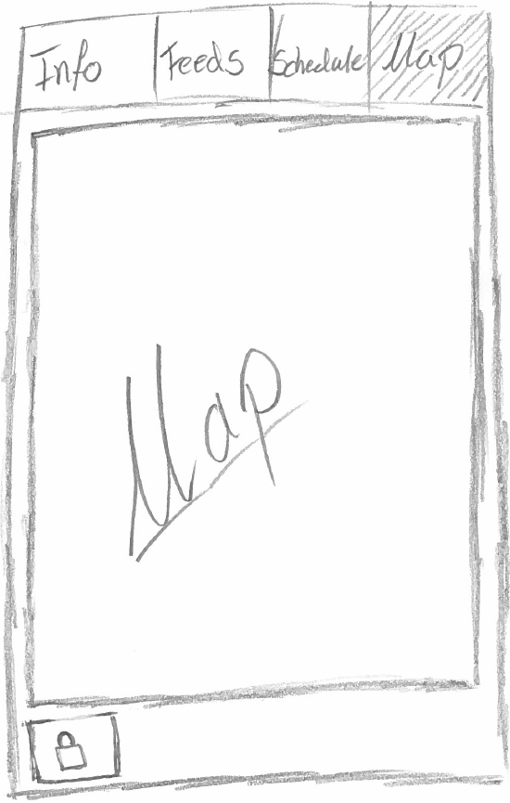
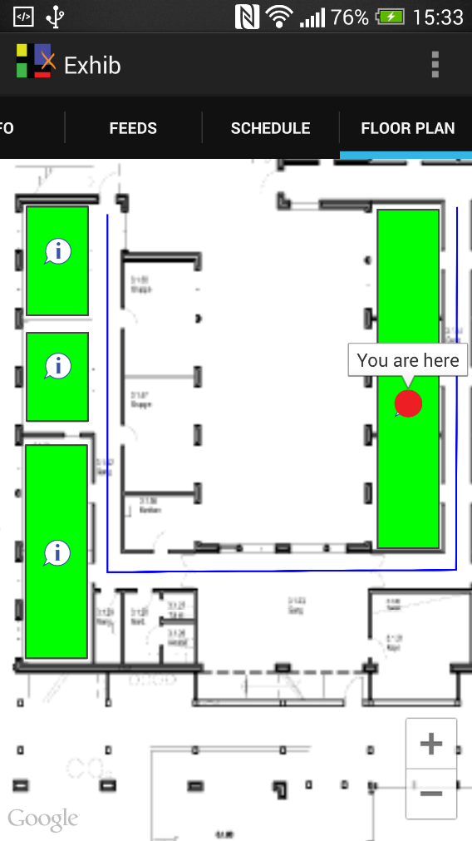
Motivation
concept
App design
Floor plan
Website
Server communication
conclusion
demonstration
Map
8 OF 17 | 15.02.2014
Department of computer science
AALBORG UNIVERSITy

Slide 16
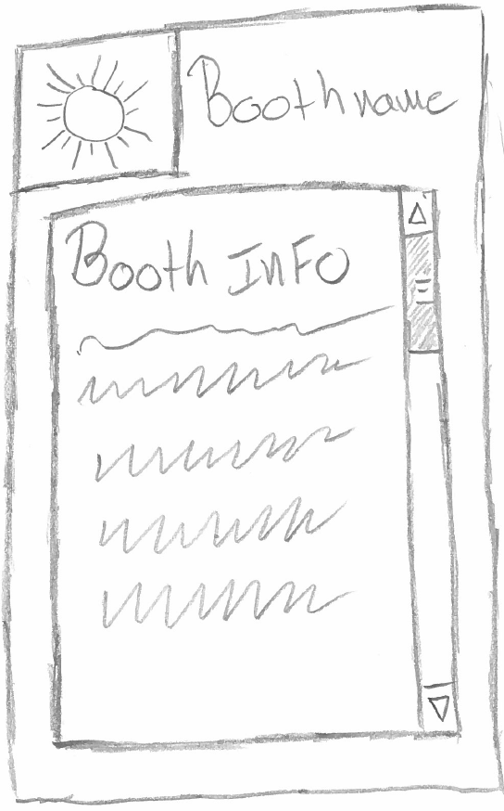
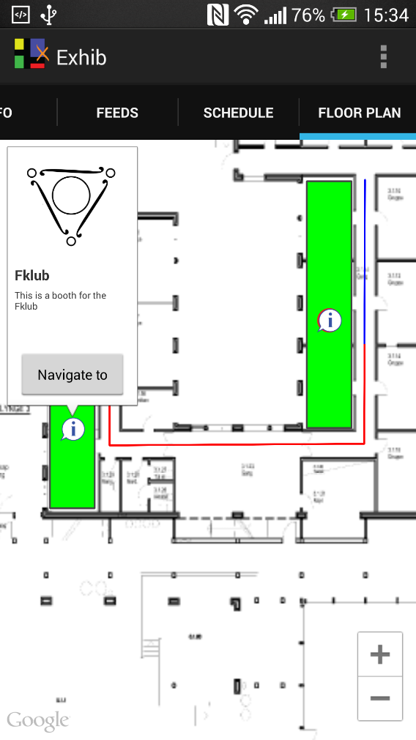
Motivation
concept
App design
Floor plan
Website
Server communication
conclusion
demonstration
Map
8 OF 17 | 15.02.2014
Department of computer science
AALBORG UNIVERSITy

Slide 17
Floor Plan
Jesper R. Andersen

Slide 18
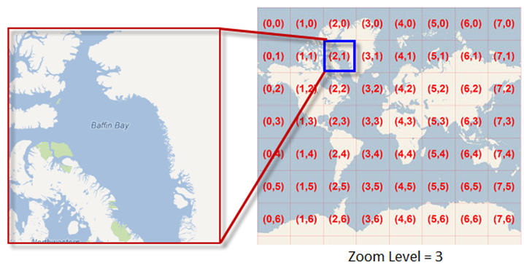
Motivation
concept
App design
Floor plan
Website
Server communication
conclusion
demonstration
Floor plan
Webview vs. mapfragment
Performance
Tile set
10 OF 17 | 15.02.2014
Department of computer science
AALBORG UNIVERSITy

Slide 19
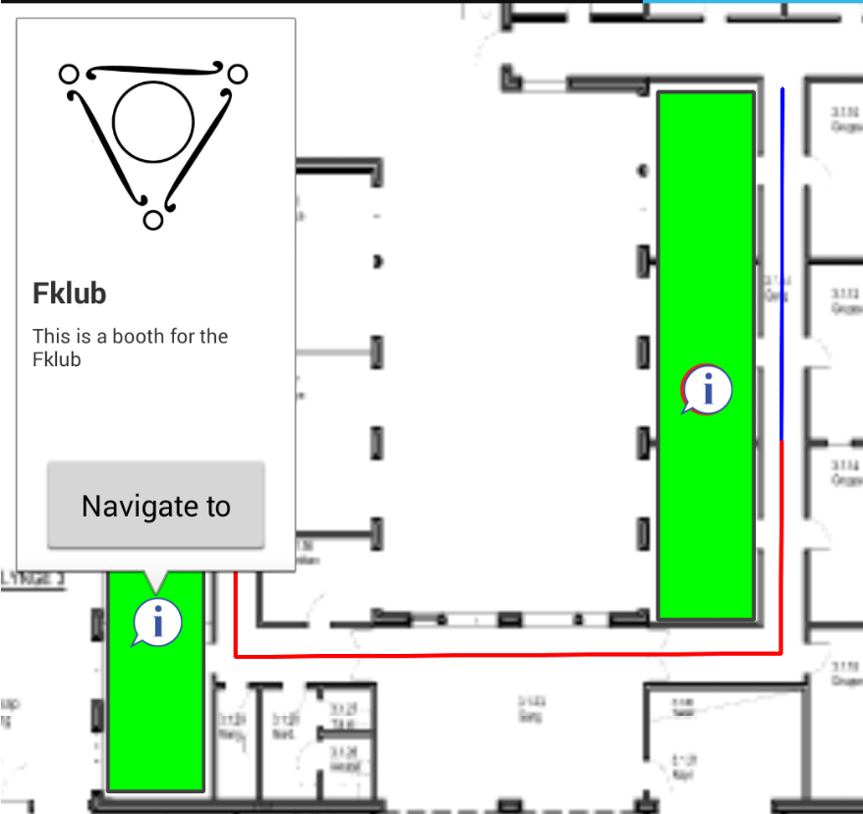
Motivation
concept
App design
Floor plan
Website
Server communication
conclusion
demonstration
Floor plan
shapes and elements
Makers
Polygons
Polylines
Info window
10 OF 17 | 15.02.2014
Department of computer science
AALBORG UNIVERSITy

Slide 20
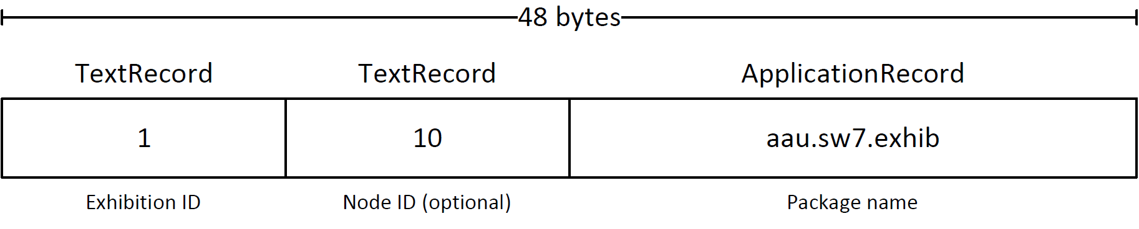
Motivation
concept
App design
Floor plan
Website
Server communication
conclusion
demonstration
NFC
NFC Tag data
NFC implementation
10 OF 17 | 15.02.2014
Department of computer science
AALBORG UNIVERSITy

Slide 21
Website
Henrik Klarup

Slide 22
Motivation
concept
App design
Floor plan
Website
Server communication
conclusion
demonstration
website Tool
Administration tool
Feeds
Company
Exhib
Schedule
Floor plan
12 OF 17 | 15.02.2014
Department of computer science
AALBORG UNIVERSITy

Slide 23
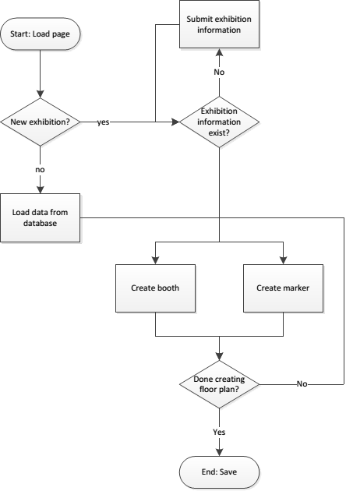
Motivation
concept
App design
Floor plan
Website
Server communication
conclusion
demonstration
Website flow
12 OF 17 | 15.02.2014
Department of computer science
AALBORG UNIVERSITy

Slide 24
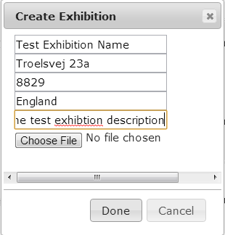
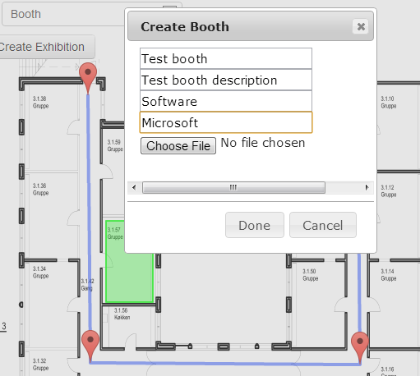
Motivation
concept
App design
Floor plan
Website
Server communication
conclusion
demonstration
Website creation
12 OF 17 | 15.02.2014
Department of computer science
AALBORG UNIVERSITy

Slide 25
Motivation
concept
App design
Floor plan
Website
Server communication
conclusion
demonstration
Features of the website
Features
Create and edit exhibitions
Create feeds and schedules
Create an exhibition floor plan
Missing Features
Login system
Automatic tile creation from website
12 OF 17 | 15.02.2014
Department of computer science
AALBORG UNIVERSITy

Slide 26
Server Communication
Nicklas Andersen

Slide 27
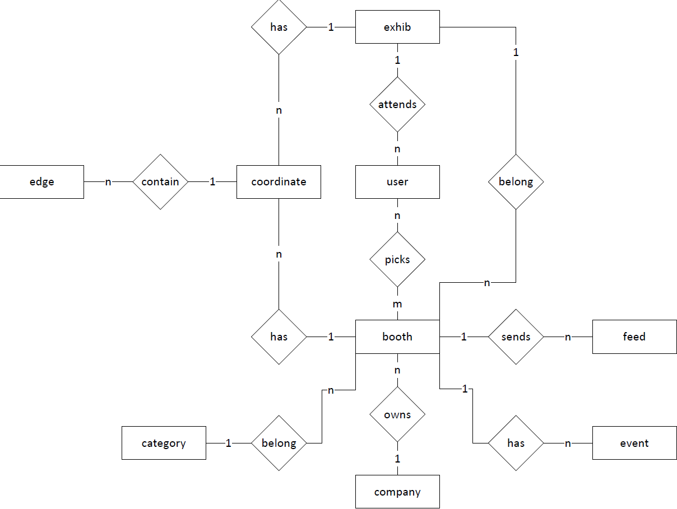
Motivation
concept
App design
Floor plan
Website
Server communication
conclusion
demonstration
Database
Why a Database
12 OF 17 | 15.02.2014
Department of computer science
AALBORG UNIVERSITy

Slide 28
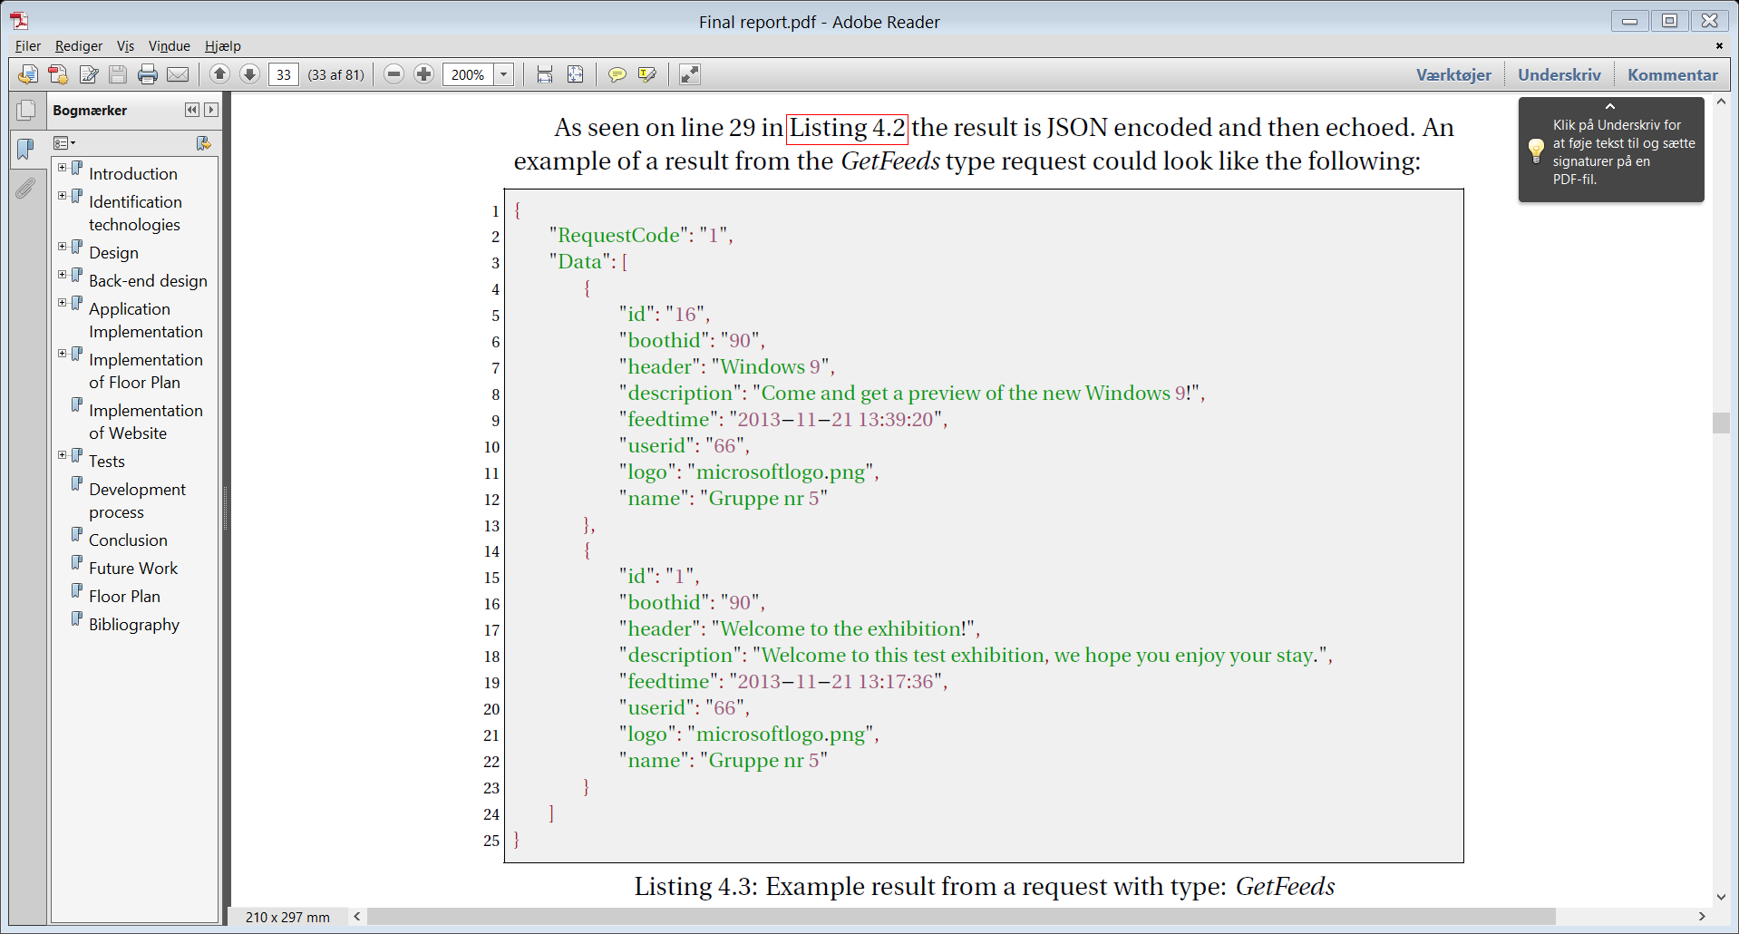
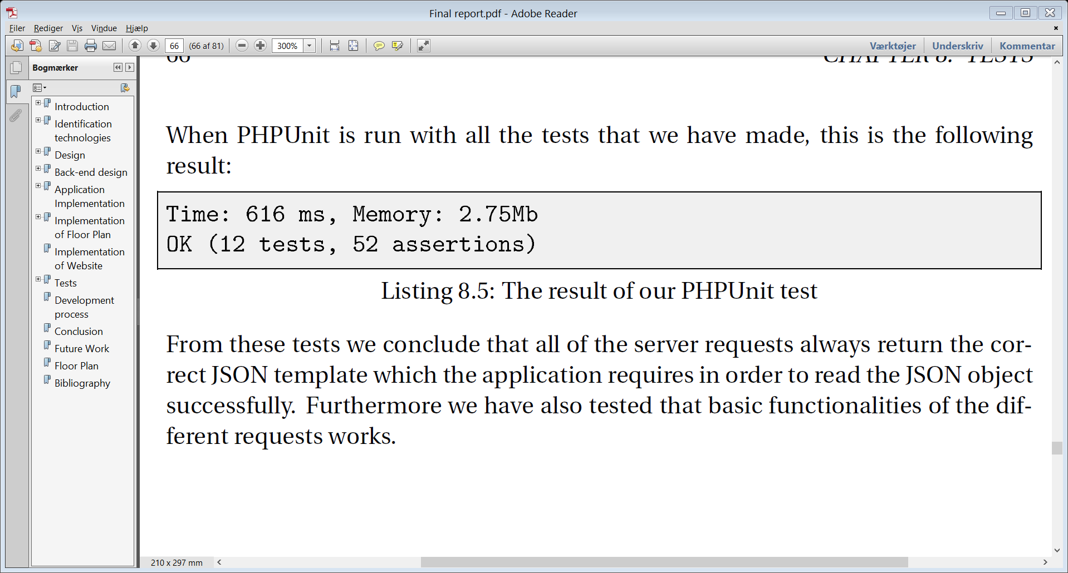
Motivation
concept
App design
Floor plan
Website
Server communication
conclusion
demonstration
API
API PArameters
Request Code
Type
User id
Limit
Timestamp
Exhib Id
Example
requestcode = 1
Type = Getfeeds
User id = 1
Limit = 10
Unit Testing
12 OF 17 | 15.02.2014
Department of computer science
AALBORG UNIVERSITy

Slide 29
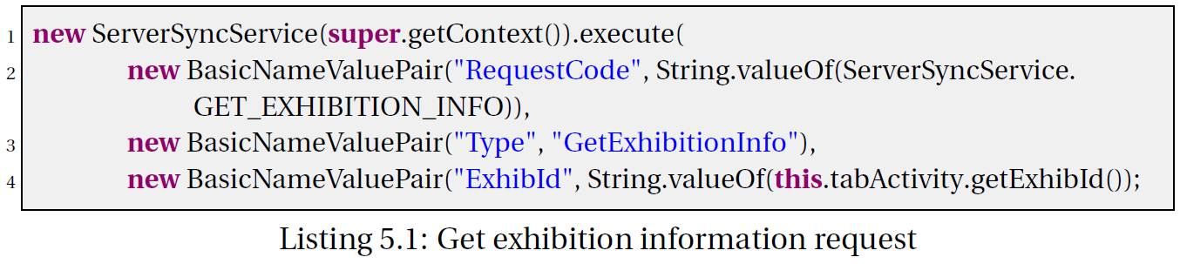
Motivation
concept
App design
Floor plan
Website
Server communication
conclusion
demonstration
Serversyncservice
Async
Request code
12 OF 17 | 15.02.2014
Department of computer science
AALBORG UNIVERSITy

Slide 30
Conclusion
Jacob K. Wortmann

Slide 31
Motivation
concept
App design
Floor plan
Website
Server communication
conclusion
demonstration
Conclusion
implemented website tool, android application, and a server service
Personalise the application
The three parts functions and work well with each other
WE believe that the application will help navigation issues.
12 OF 17 | 15.02.2014
Department of computer science
AALBORG UNIVERSITy

Slide 32
Demonstration
Nicklas and Jesper

